Slide 1

--Expansion--
Scope Analysis
BY
MR. SAPTARSHI MAJUMDER
21-05-2024

Slide 2
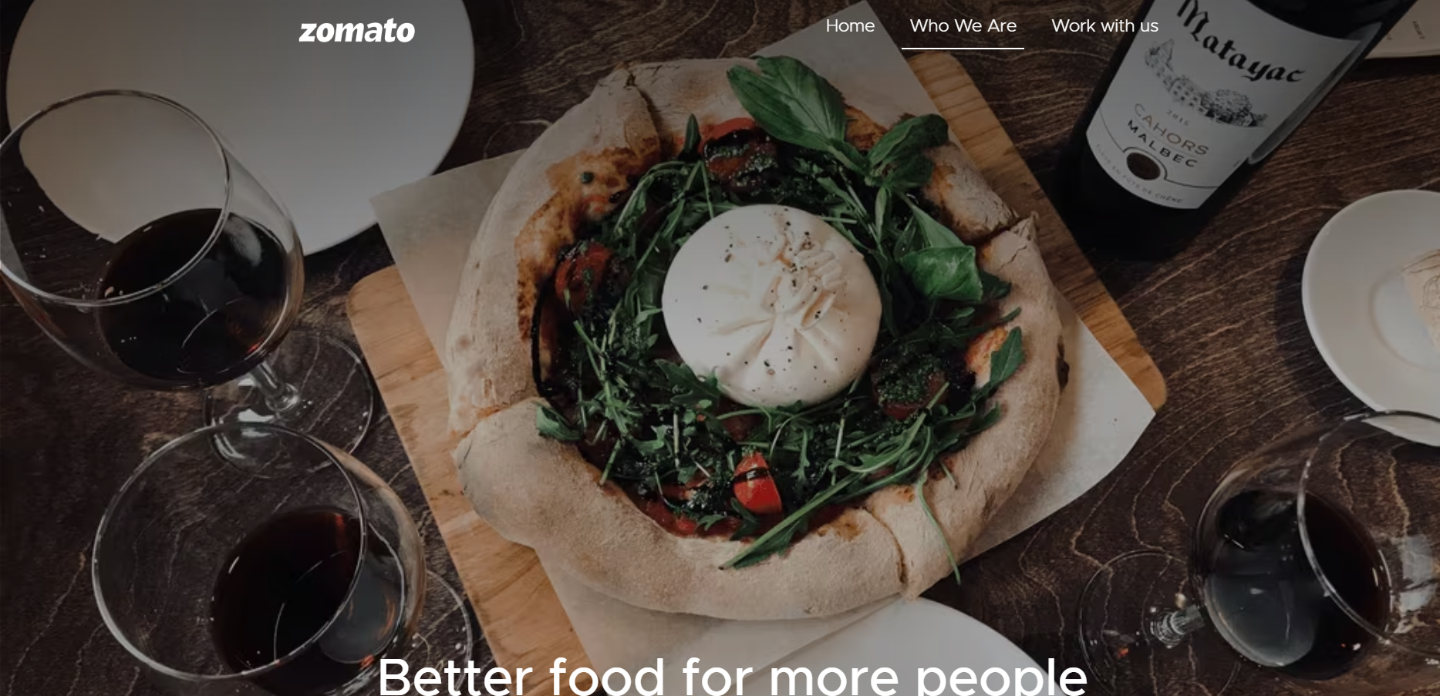

What is :
Launched in 2010, Our technology platform connects customers, restaurant partners and delivery partners, serving their multiple needs.
Customers use our platform to search and discover restaurants, read and write customer generated reviews and view and upload photos, order food delivery, book a table and make payments while dining-out at restaurants.
On the other hand, we provide restaurant partners with industry-specific marketing tools which enable them to engage and acquire customers to grow their business while also providing a reliable and efficient last mile delivery service.
We also operate a one-stop procurement solution, Hyperpure, which supplies high quality ingredients and kitchen products to restaurant partners. We also provide our delivery partners with transparent and flexible earning opportunities.

Slide 3


Data Summary
Total number of restaurant is 9551 including all the countries data.
Total number of voters on all countries is 1498645.
Total avg. Rating of all available countries data is 2.89126793.
Total sum of avg. Cost for two 11453662.
This data helps to build a understanding the current food market of different regions of different countries across the globe.
Data Cleaning and pre-processing output
The data was cleaned of missing values and replaced date column sign ‘_’ with ‘-’ for getting year.
Unified the price with currency abbreviation/symbol into a customised column.
The name of the country was introduced according to country for better cross - reference.
This country based restaurant data is crucial for current market analysis of current cuisine trend, customer preference, competitor analysis and restaurant performance analysis.
Insights for expansion is greatly dependent on the user preference and competition on particular countries.

Slide 4



Data cleaning – Deleted missing values data rows as it was less than 5% of the data and removed duplicates to ensure data accuracy.
Data enrichment – Data was enhanced by using xlookup function for country name and customized price column for cross reference with the external data sources.
Descriptive analysis – Pivot table’s were used to summarize the data for understanding the cuisine and year trend in the ongoing market of regions of different countries, along with the big competitors data of specific regions of different countries.
Customer preference analysis – Conducted cuisine based customer analysis in different regions of different countries using the avg. Rating.
Restaurant performance analysis – Used rating and average cost to make an overview of performance for restaurants of different regions of different countries.
Visualization – Dynamic charts and dashboard are created for user interaction with data exploration.

Slide 5
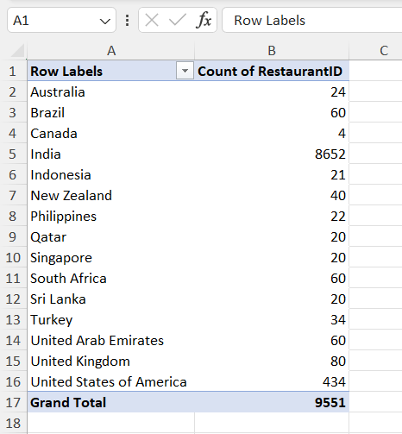
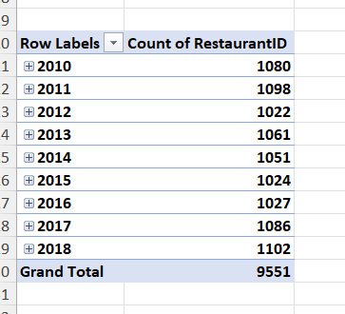

The maximum number of restaurant are mostly present in the country India and United States of America i.e. there will be higher competitions.
In the year from 2016-2018 there is a subsequent growth in number of restaurant across the globe mainly in India.

Slide 6
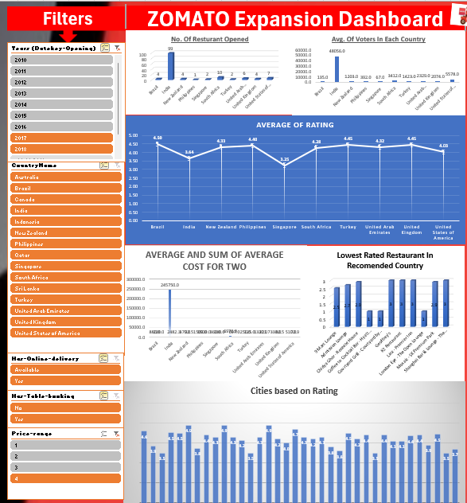

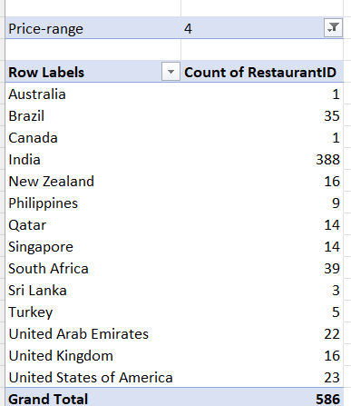
In the price range of 4 India has the highest number of restaurant present.
The number of average voters for price range of 4 became a lot lesser compare to price range 1-3.

Slide 7
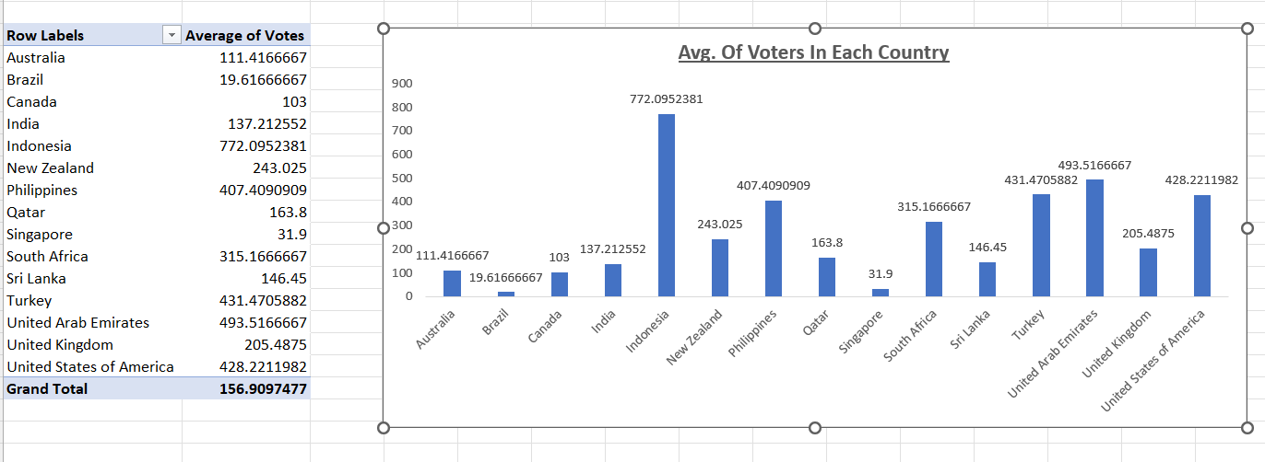

Avg. Of voters helps us to understand in which country number of customer is the highest and lowest.
The number of average voters are the highest in Indonesia, Philippines, Turkey, United Arab Emirates and United States of America.
Singapore and Brazil has the lowest number of avg. Voters.

Slide 8
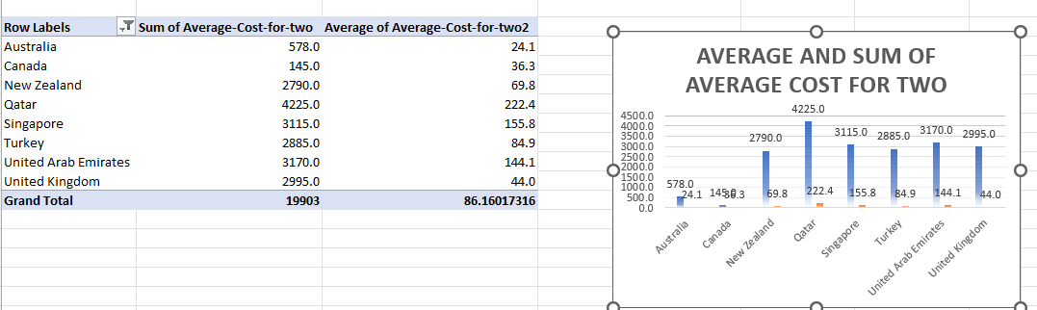
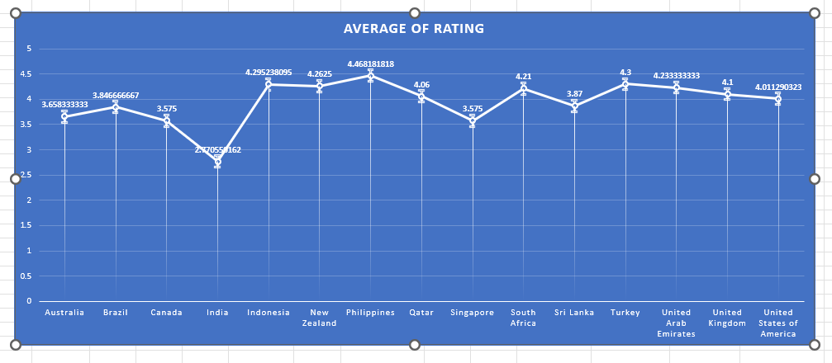
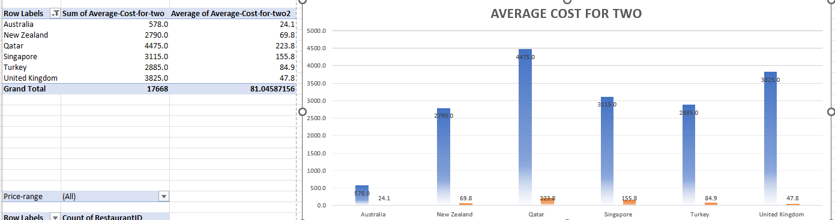
The suggested countries are based on average of rating, average and sum of average cost for two and also countries with lesser competition.
These are based on sum of average cost for two “<=5000” with their average rating >=3.5 and count of restaurant in between 20 to 80.
These helps to understand which country expansion will be scalable.

Slide 9
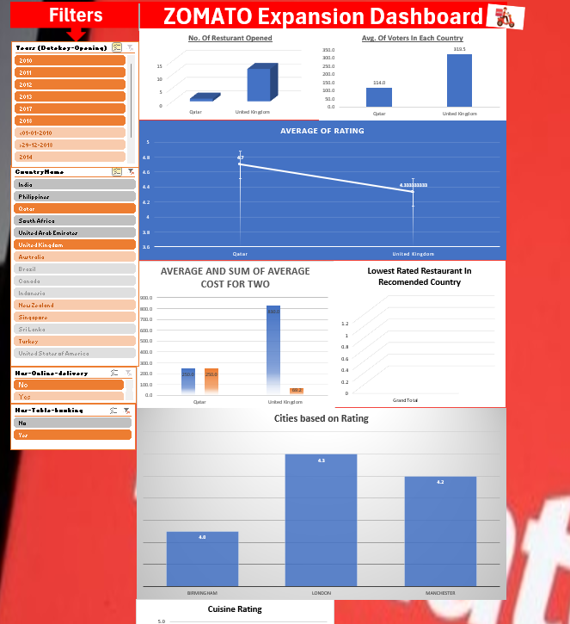
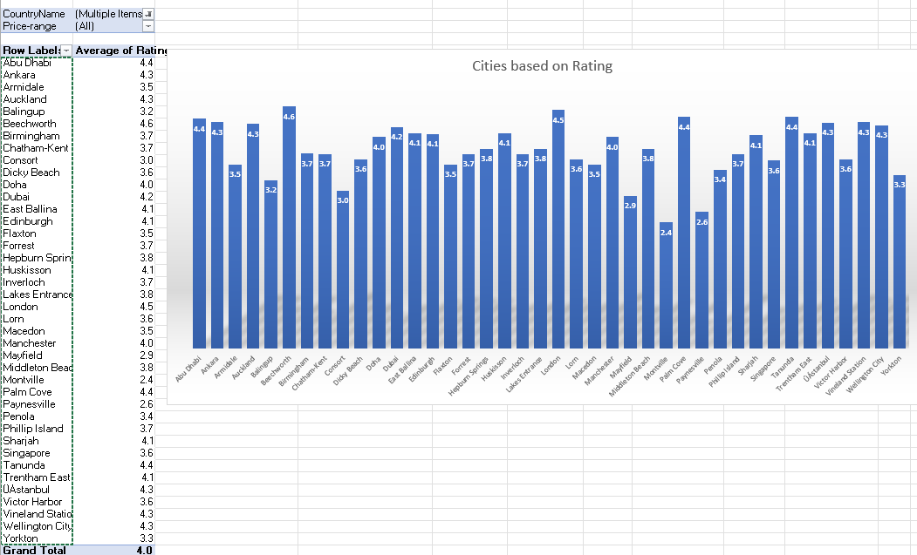
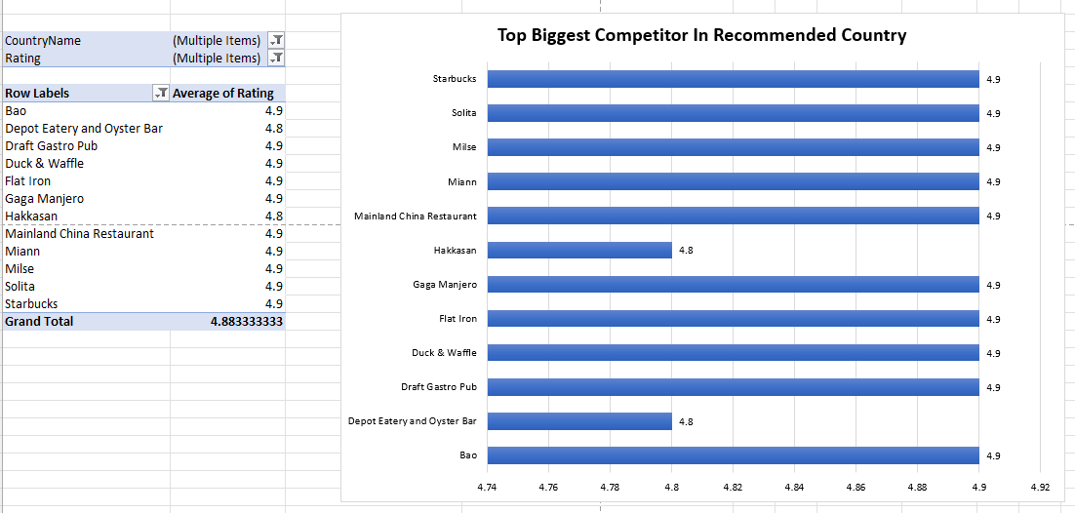
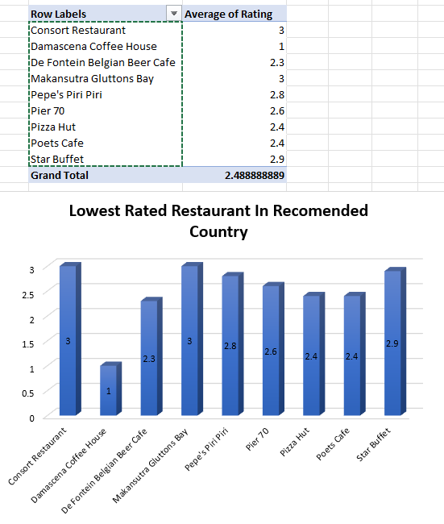
Came up with specific states and city names based on online delivery, avg. Rating and price range in which Zomato can have a successful campaign.
Also with top biggest competitors and lowest rated restaurant name of those specific suggested countries with the help of average of rating.
These are the states and cities name in the suggested countries who have rating “>=3.5” with price range of 1-3.

Slide 10
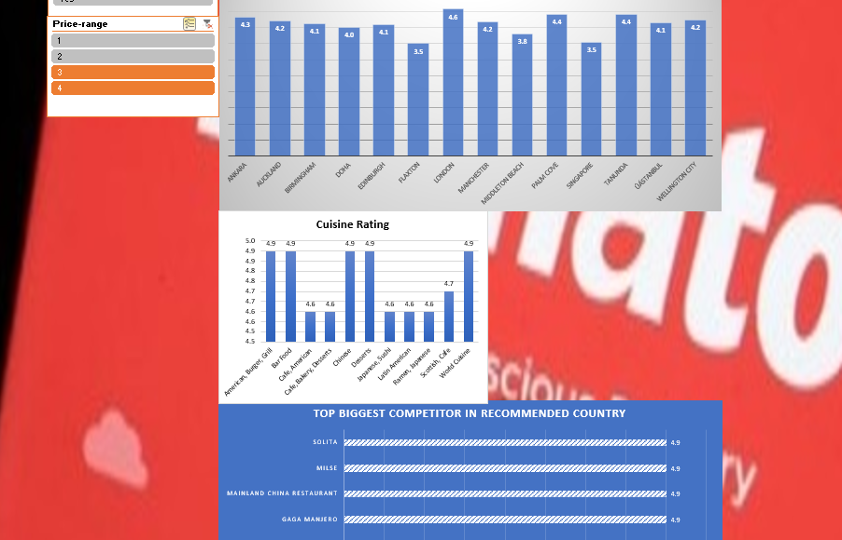
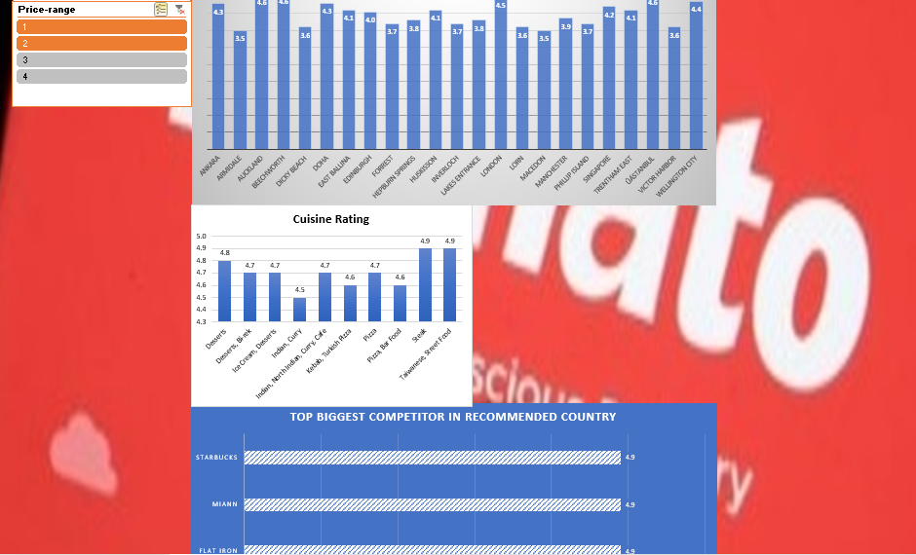
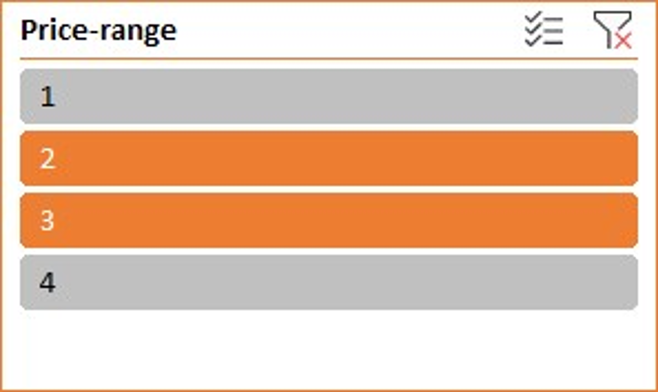
Suggested cuisines based on data of rating in the suggested countries.
The suggestion are based on high rated cuisines in those specific countries.
Higher the price range lower is the number of restaurants present.
The price range of 1-3 has the maximum of voters.
The price range of 2-3 has the highest average rating.
These data shows which price range to focus on and with which cuisine for better customer satisfaction..

Slide 11

Recommended Countries For Expansion:-
Countries-
Australia.
Canada.
New Zealand.
Qatar.
Singapore.
Turkey.
United Arab Emirates.
United Kingdom.
Selection Criteria –
Sum of average cost for two “<=5000”.
Average rating ‘>=3.5’.
Count of restaurant in between 20 to 80.
As per our data we can expect to have a higher chance of success in these countries as they satisfy the price range and also has a low competitor market.
Online delivery can bring a greater impact to these countries as they do not have any online food delivery services.

Slide 12
States Data Suitable For Expansion:-
Abu Dhabi
Ankara
Armidale
Auckland
Balingup
Beechworth
Birmingham
Chatham-Kent
Consort
Dicky Beach
Doha
Dubai
East Ballina
Edinburgh
Flaxton
Forrest
Hepburn Springs
Huskisson
Inverloch
Lakes Entrance
London
Lorn
Macedon
Manchester
Mayfield
Middleton Beach
Montville
Palm Cove
Paynesville
Penola
Phillip Island
Singapore
Tanunda
Trentham East
ÛÁstanbul
Victor Harbor
Vineland Station
Wellington City
Yorkton
Sharjah
Selection Criteria
Price range of ‘1-3’.
Average rating ‘>=3.5’.
These locations has rating above 3.5 and also satisfy the price range of 1-3.
The higher rating indicate a good market of consumers availability and also has cost efficiency.

Slide 13

Recommended Cuisines
American, Asian, Burger
American, BBQ, Sandwich
American, Desserts
American, Desserts, Steak
American, Sandwich, Salad
American, Sandwich, Tea
American, Seafood, Sushi
American, Southern, Southwestern
BBQ, Burger, Desserts
BBQ, Caribbean, Seafood
Brazilian, Steak
Breakfast, Mexican
British, Bar Food, Sandwich
Burger, Bar Food, Steak
Burger, Sandwich, Seafood
Cajun
Cuban, Spanish
Desserts, Bar Food
Desserts, Bí-rek
Hawaiian
Hawaiian, Seafood
Hawaiian, Seafood, Steak
Indian, Continental
Indian, Rajasthani
International, Italian, Southern
Italian, Deli
Latin American, Mexican, Southwestern
Mexican, Vegetarian
New American, Tapas
Pub Food
World Cuisine, Patisserie, Cafe
Sum Of Voter’s ‘>1000’.
Average rating ‘>4.3’.
Expected to have a positive impact on the consumers as those are in the bracket’s of highest restaurant rating.

Slide 14
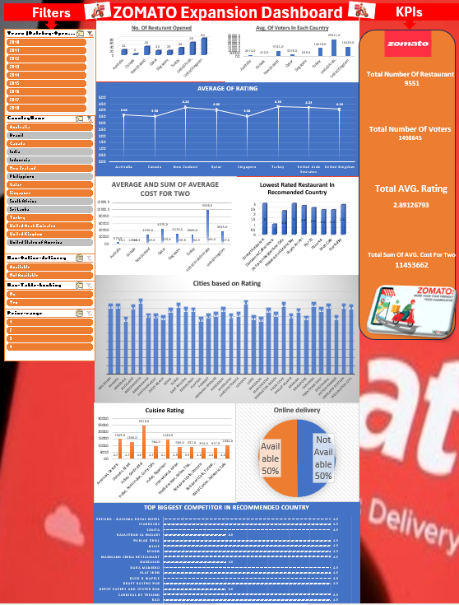
Dashboard Data Visualization
In this visualized data we can see the current number of restaurant, average of voters and their ratings, city rating, highest rated cuisines and who are the biggest competitors for zomato.
This dashboard can used to see different scenarios of cuisine and the cost along with the highest rated restaurant to help decide the location for expansion and the chances of success.
The filters present can be used to visualize year wise data, also country wise, whether they have online delivery or table booking system ongoing or in which price range are the response and rating are higher.

Slide 15

Conclusion
Customer response – Analyzed customer preference and rating affecting the restaurant based on cuisine.
New market penetration – The top competitors has been identified, along with the lowest rated restaurant in those suggested countries.
Pattern analysis – The relation between high rated restaurant and their cuisine explains the pattern of customer analysis along with the price bracket to aims for.
“Our statistical analysis gives an overall view of impact according to the decision. The customer satisfaction, cuisine related rating increase or decrease gives us an insight how to increase market share of Zomato across the globe. The suggestion made were just not speculations it’s based on careful analysis of trend and behavior as well the location impact on the business. This gives us an edge for a successful business expansion”.

Slide 16

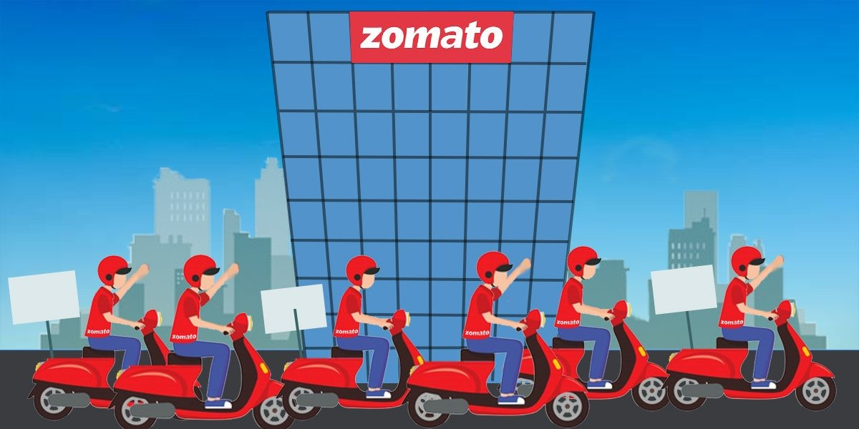
Reference-
sample slide.
TA session with prince poonia.
the Zomato website.

